Slide 1
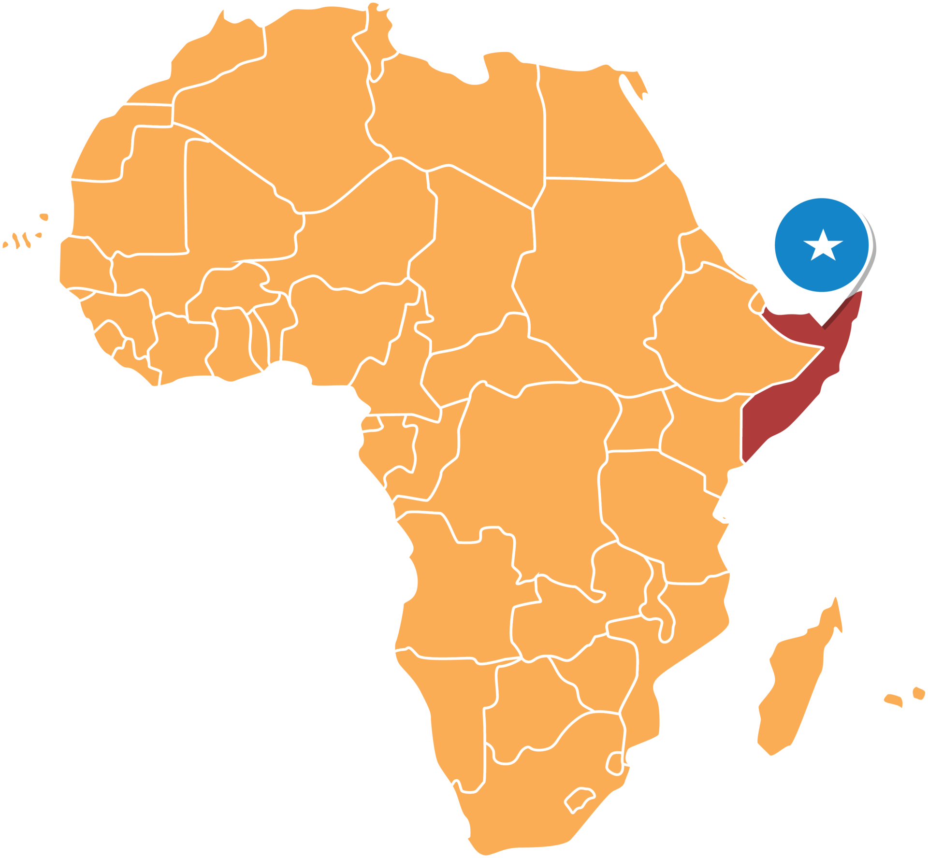
Federal Republic of Somalia

Slide 2

About the country.
Country Info.
Flag of Somalia.
Federal Member States.
Capital and Largest city.
Regions and Major Cities.
Former Presidents.
Outlines

Slide 3
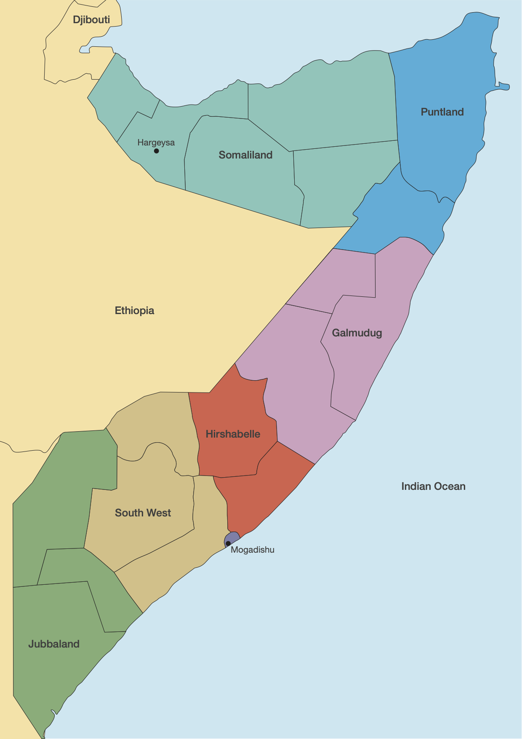
Somalia, officially the Federal Republic of Somalia, is the easternmost country in continental Africa. The country is located in the Horn of Africa and is bordered by Ethiopia to the west, Djibouti to the northwest, Kenya to the southwest, the Gulf of Aden to the north, and the Indian Ocean to the east.

Slide 4
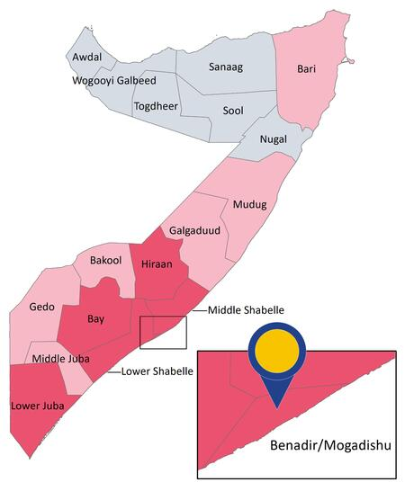
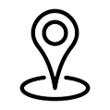
Mogadishu is the capital and largest city of Somalia, located in the Banadir region along the coast of the Indian Ocean. It is the political, economic, and cultural heart of Somalia.
Mogadishu is Somalia’s main financial and industrial center. Key industries include trade, telecommunications, construction, and services. The city's port plays a vital role in international trade

Slide 5


